Slide 1
Data Structures
AMOL R PATIL - 9822291613NE

Slide 2
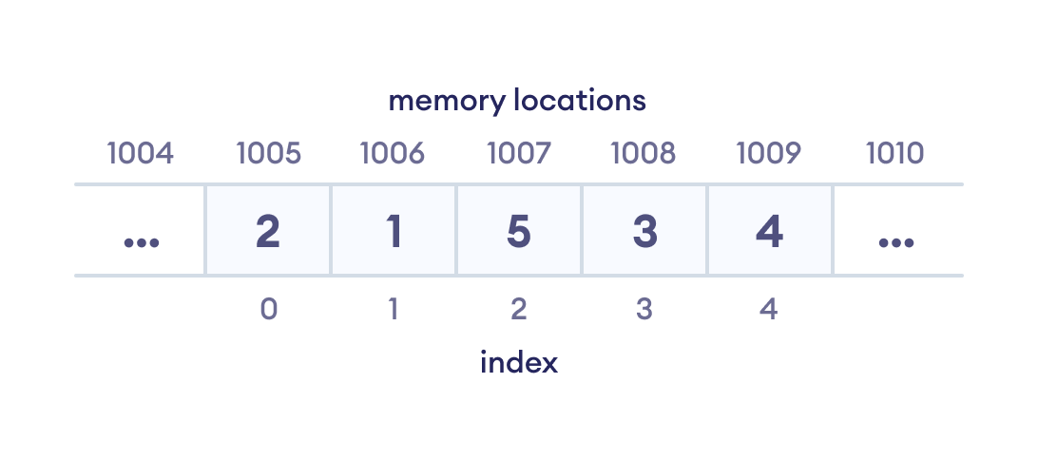
What is Data Structure ?
The data structure name indicates itself that organizing the data in memory
The simple definition for the data structure is that “different ways of storing data on your computer” or “the systematic way of representing and organizing your data”.

Slide 3
What is Algorithm ?
An algorithm is a set of well-defined instructions to solve a particular problem. It takes a set of input(s) and produces the desired output
Step 1: Start
Step 2: Declare variables n, factorial and i.
Step 3: Initialize variables
factorial ← 1
i ← 1
Step 4: Read value of n
Step 5: Repeat the steps until i = n
5.1: factorial ← factorial*i
5.2: i ← i+1
Step 6: Display factorial
Step 7: Stop

Slide 4
Data Structure and Algorithms
Data structures usually work together with algorithms. They hold the data while algorithms solve problems using the data.

Slide 5
Algorithm Complexity
Suppose X is an algorithm and n is the size of input data, the time and space used by the algorithm X are the two main factors, which decide the efficiency of X.
Time Factor − Time is measured by counting the number of key operations such as comparisons in the sorting algorithm.
Space Factor − Space is measured by counting the maximum memory space required by the algorithm.
The complexity of an algorithm f(n) gives the running time and/or the storage space required by the algorithm in terms of n as the size of input data.

Slide 6
Algorithm Complexity
There are three cases in the analysis of an algorithm, which are as follows:
Best case
Average case
Worst Case

Slide 7
Time Complexity
Time complexity is defined as the amount of time taken by an algorithm to run, as a function of the length of the input.
It aids in our analysis of the algorithm's performance scaling with increasing input size.
Time complexity is frequently expressed using Big O notation. It represents the maximum possible running time for an algorithm given the size of the input.

Slide 8
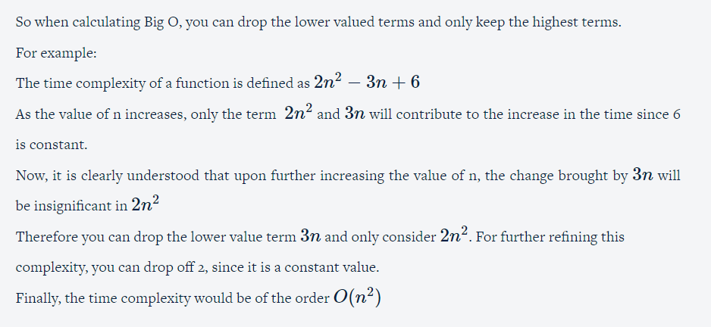
Big O Notation

Slide 9
O(n): known as Linear complexity
1 item: 1 operation 10 items: 10 operations 100 items: 100 operations
O(n^2): known as Quadratic complexity
1 item: 1 operation 10 items: 100 operations 100 items: 10,000 operations
O(1): known as Constant complexity
1 item: 1 operation 10 items: 1 operation 100 items: 1 operation
O(log n): known as Logarithmic complexity
1 item: 1 operation 10 items: 2 operations 100 items: 3 operations 1000 items: 4 operations 10,000 items: 5 operations
Big O Notation

Slide 10
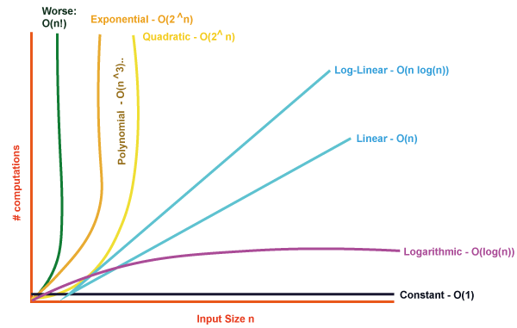
Big O Notation
Time complexity is frequently expressed using Big O notation. It represents the maximum possible running time for an algorithm given the size of the input
𝑂(1) > 𝑂(𝑙𝑜𝑔 𝑛) > 𝑂(𝑛) > 𝑂(𝑛 𝑙𝑜𝑔 𝑛) > 𝑂(𝑛2) > 𝑂 (𝑛3)

Slide 11
Big O Notation
O(1) (Constant Time): This is like saying a car can go 60 miles per hour no matter how long the trip is. It means the program's execution time doesn't depend on the input size.
O(log n) (Logarithmic Time): Imagine you're cutting a phone book in half repeatedly to find a name. Even if the phone book is huge, you don't have to look at every page. This is like O(log n) where the program becomes faster as the input grows.
O(n) (Linear Time): If a program's performance is O(n), it means the time or space it takes grows directly with the size of the input. If it takes 1 second for 10 items, it might take 10 seconds for 100 items.
O(n^2) (Quadratic Time): This is like saying if you double the input, the program's execution time becomes four times longer. It grows quadratically with the input size.

Slide 12
How to Calculate Complexity ?
Identify the algorithm: Determine the specific algorithm or code snippet for which you want to calculate the time complexity. It could consist of a series of operations combined with a loop or a recursive function.
Identify the input size: Identify the elements that make up the algorithm's input size. For example, if the algorithm operates on an array, the input size could be the length of the array.
Determine the basic operations: Identify the fundamental operations that contribute to the running time of the algorithm. These operations could be comparisons, assignments, arithmetic operations, function calls, or any other significant actions.
Count the operations: Analyze how many times each basic operation is executed as a function of the input size. You may need to consider different scenarios or branches within the algorithm.

Slide 13
How to Calculate Complexity ?
Express the count as a function of the input size: Create a mathematical expression that represents the count of basic operations as a function of the input size. It ought to outline the worst-case scenario or the performance limit of the algorithm.
Simplify the expression: Simplify the mathematical expression by removing constants, lower-order terms, and insignificant factors. Focus on the most dominant term that represents the growth rate of the algorithm.
Determine the time complexity notation: Use Big O notation to express the condensed expression, where Big O indicates the time complexity's upper bound. O(1) stands for constant time, O(n) for linear time, O(n^2) for quadratic time, and so forth are common notations.

Slide 14
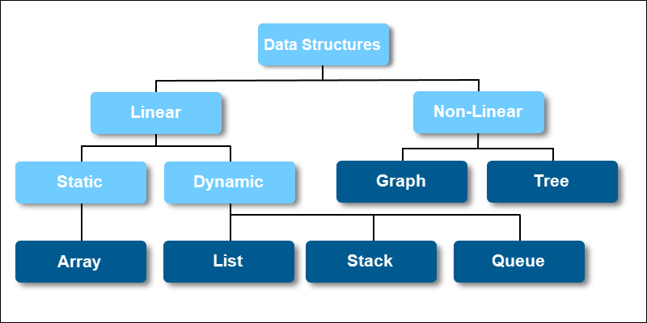
Types of Data Structures

Slide 15
Data Structure Operations
Searching: We can search for any element in a data structure.
Sorting: We can sort the elements of a data structure either in an ascending or descending order.
Insertion: We can also insert the new element in a data structure.
Updation: We can also update the element, i.e., we can replace the element with another element.
Deletion: We can also perform the delete operation to remove the element from the data structure.

Slide 16
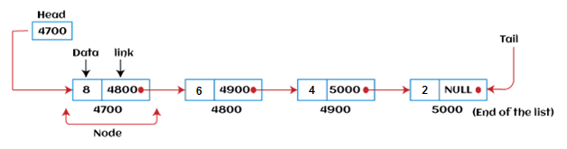
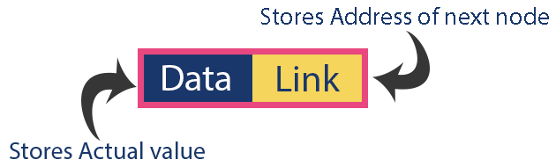
Linked List
A linked list is a linear data structure that includes a series of connected nodes. Here, each node stores the data and the address of the next node.

Slide 17
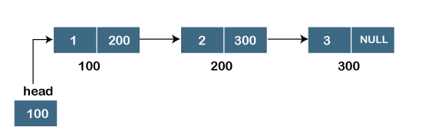
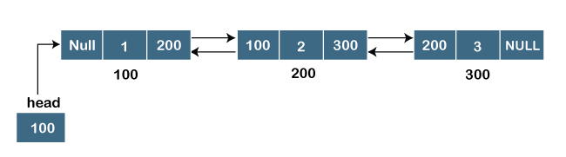
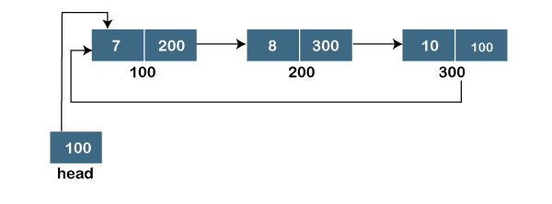
Types of Linked Lists
Singly Linked list
Doubly linked list
Circular linked list

Slide 18
Linked List Operations
Traversal : To traverse all the nodes one after another.
Insertion : To add a node at the given position.
Deletion : To delete a node.
Searching : To search an element(s) by value.
Updating : To update a node.
Sorting: To arrange nodes in a linked list in a specific order.
Merging: To merge two linked lists into one.

Slide 19
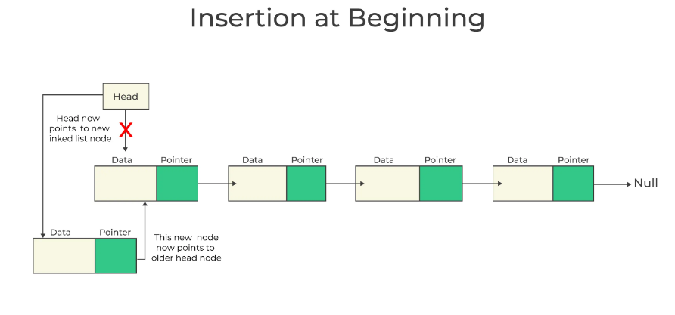

Slide 20
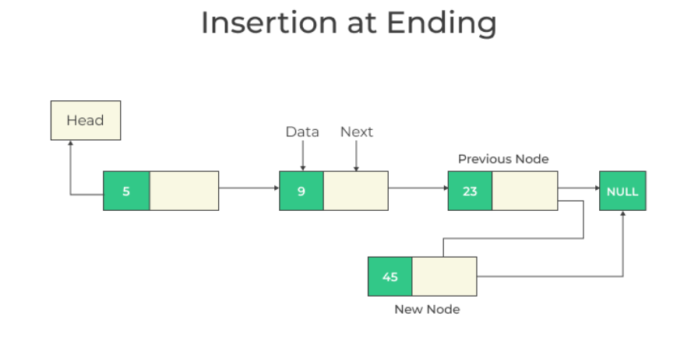

Slide 21
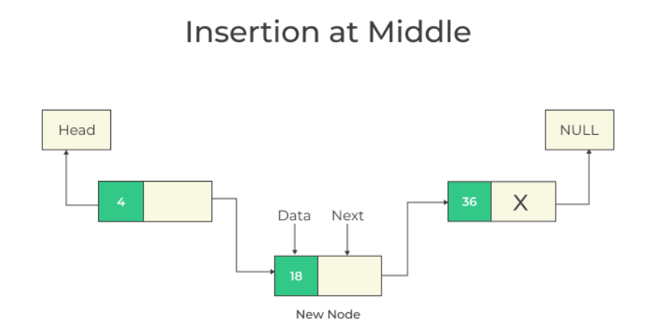

Slide 22
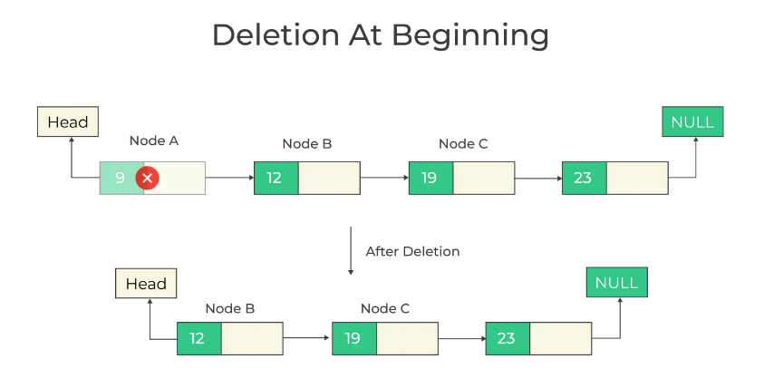

Slide 23
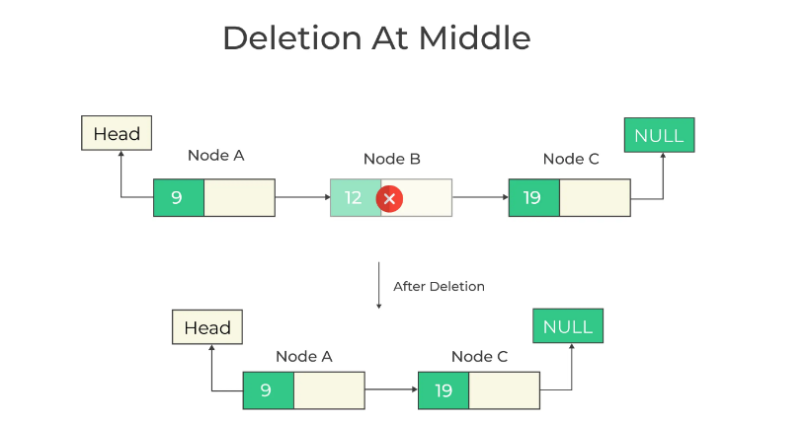

Slide 24
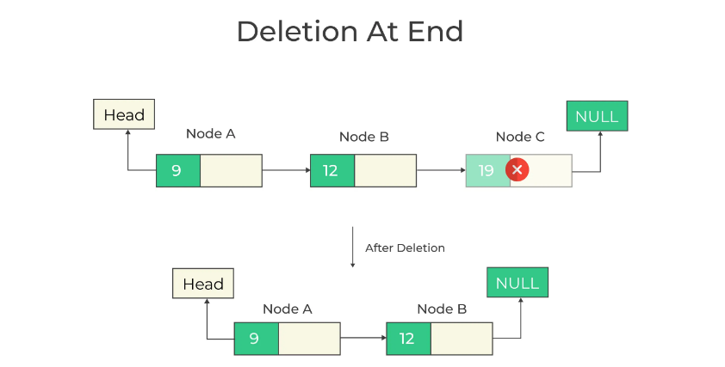

Slide 25
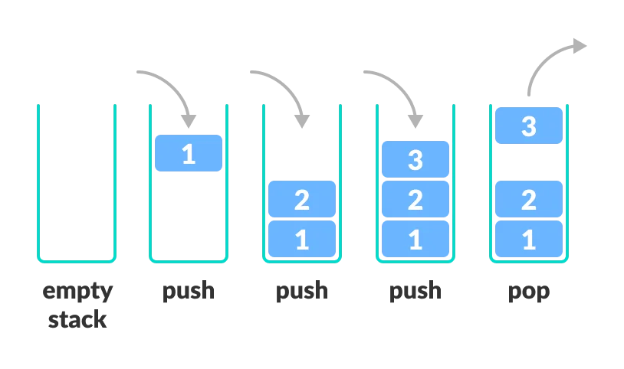
Stack
A stack is a linear data structure that follows the principle of Last In First Out (LIFO). This means the last element inserted inside the stack is removed first.

Slide 26
Stack Operations
Push: Add an element to the top of a stack
Pop: Remove an element from the top of a stack
IsEmpty: Check if the stack is empty
IsFull: Check if the stack is full
Peek: Get the value of the top element without removing it

Slide 27
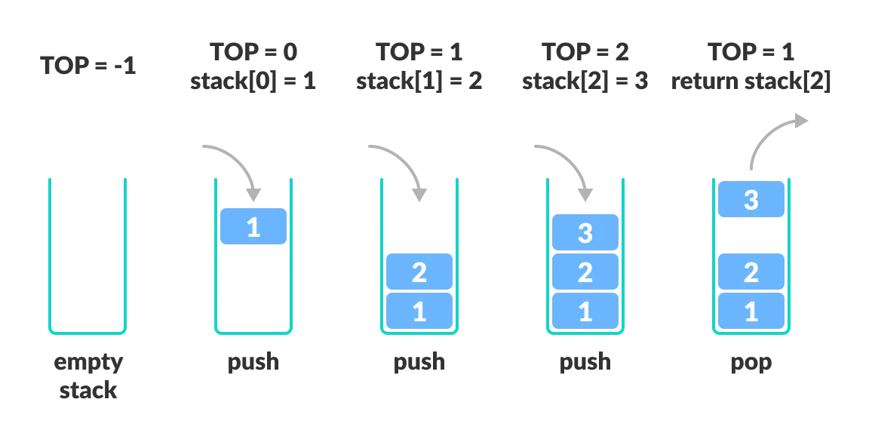
Stack Working

Slide 28
Stack Applications
Function Call Management: Stacks are used to keep track of function calls in programs. When a function is called, its context (variables, return address, etc.) is pushed onto the stack. When the function returns, its context is popped from the stack.
Expression Evaluation: Stacks are used to evaluate expressions, particularly infix expressions (e.g., arithmetic expressions). You can convert infix expressions to postfix or prefix notation and then use a stack to evaluate them.
Undo and Redo Functionality: Stacks can be used to implement undo and redo functionality in applications, allowing users to revert changes and then reapply them.
Browser History: Web browsers use stacks to keep track of the pages visited. Each new page visited is pushed onto the stack, and going back (back button) pops pages from the stack.
Parsing and Syntax Analysis: Stacks are used in parsing and syntax analysis during the compilation of programming languages. They help in tracking the structure of expressions and code blocks.

Slide 29
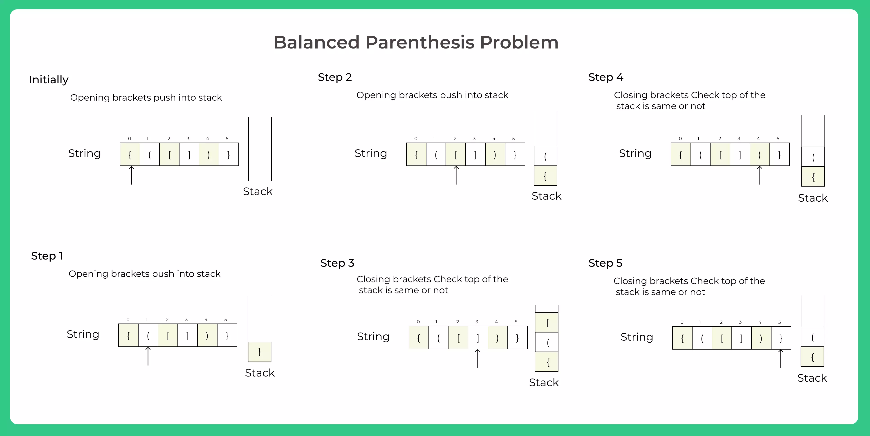
Stack Applications

Slide 30
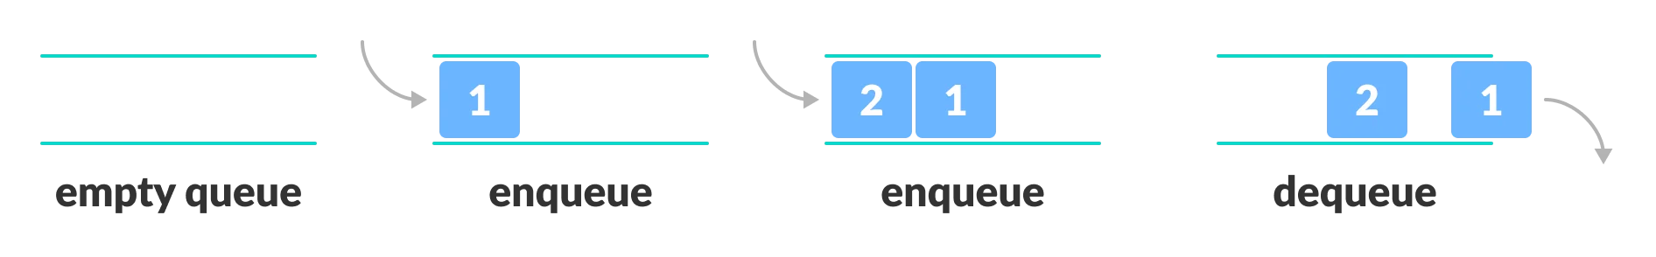
Queue
A queue is a linear data structure that follows the principle of First In First Out (FIFO). This means the first element inserted inside the queue is removed first.

Slide 31
Queue Operations
Enqueue: Add an element to the end of the queue
Dequeue: Remove an element from the front of the queue
IsEmpty: Check if the queue is empty
IsFull: Check if the queue is full
Peek: Get the value of the front of the queue without removing it

Slide 32
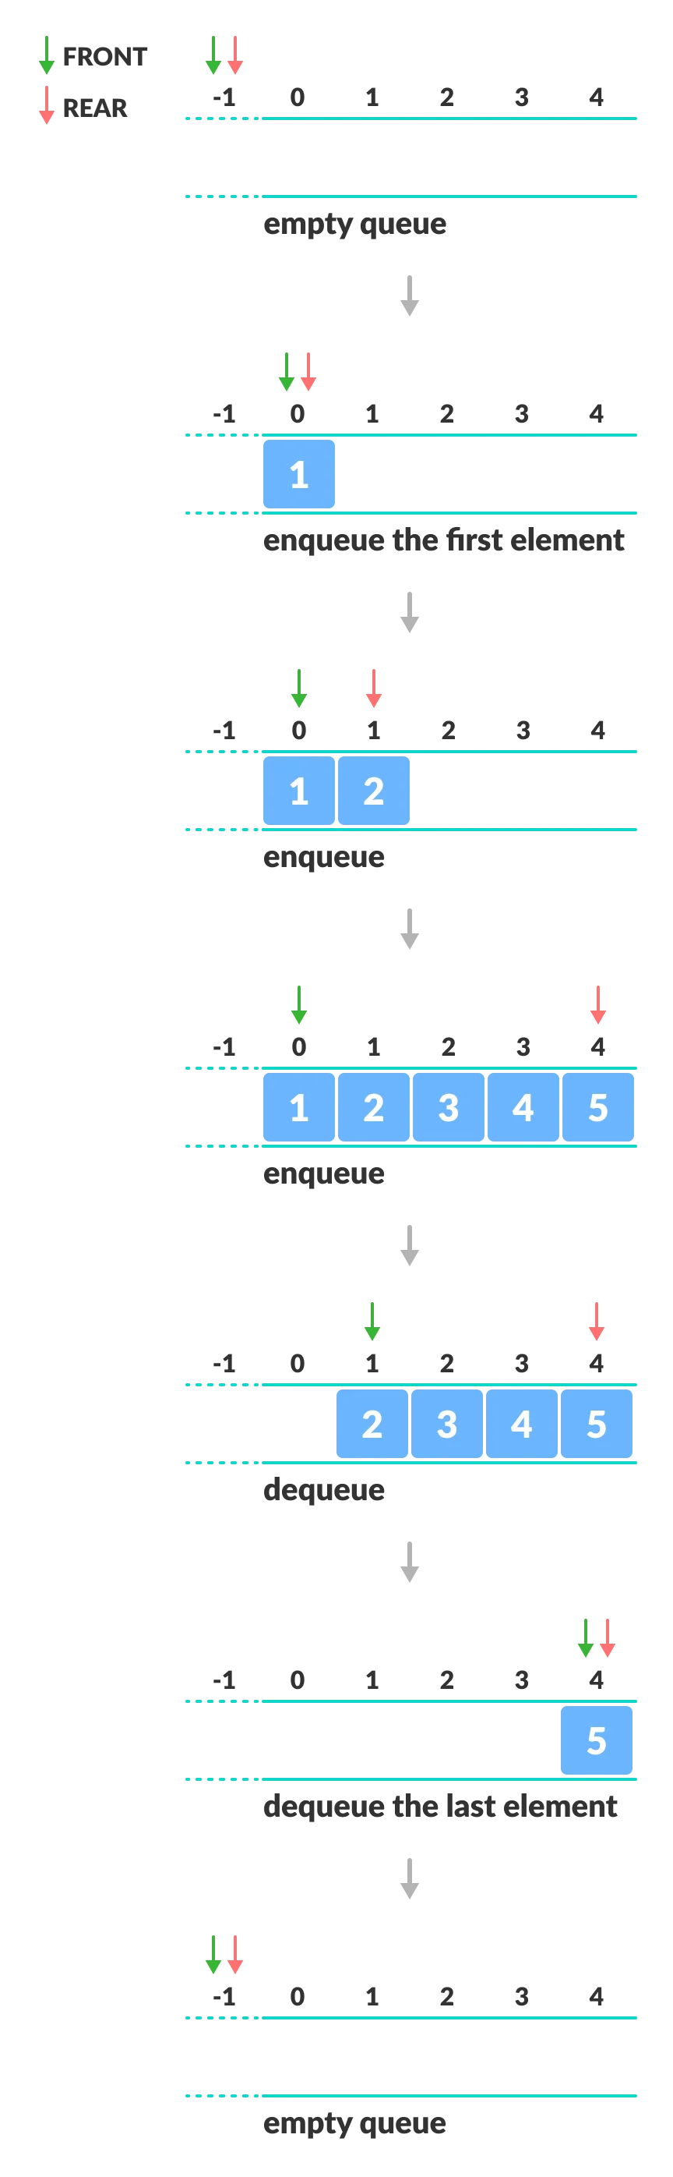
Working of Queue

Slide 33
Types of Queue
Circular Queue
Priority Queue
Double Ended Queue

Slide 34
Applications Of Queue
Task Scheduling: Queues can be used to schedule tasks based on priority or the order in which they were received.
Resource Allocation: Queues can be used to manage and allocate resources, such as printers or CPU processing time.
Batch Processing: Queues can be used to handle batch processing jobs, such as data analysis or image rendering.
Message Buffering: Queues can be used to buffer messages in communication systems, such as message queues in messaging systems or buffers in computer networks.
Event Handling: Queues can be used to handle events in event-driven systems, such as GUI applications or simulation systems.

Slide 35
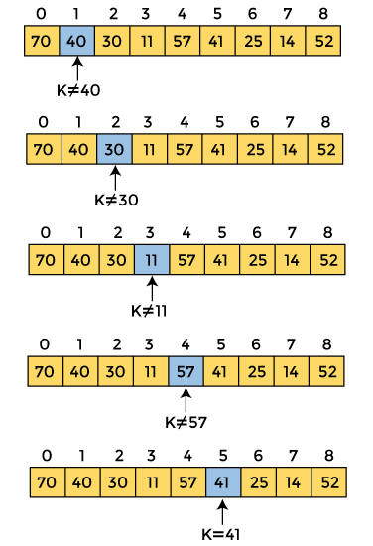
Linear Search Algorithm
Case | Time Complexity
Best Case | O(1)
Average Case | O(n)
Worst Case | O(n)
Space Complexity | O(1)

Slide 36
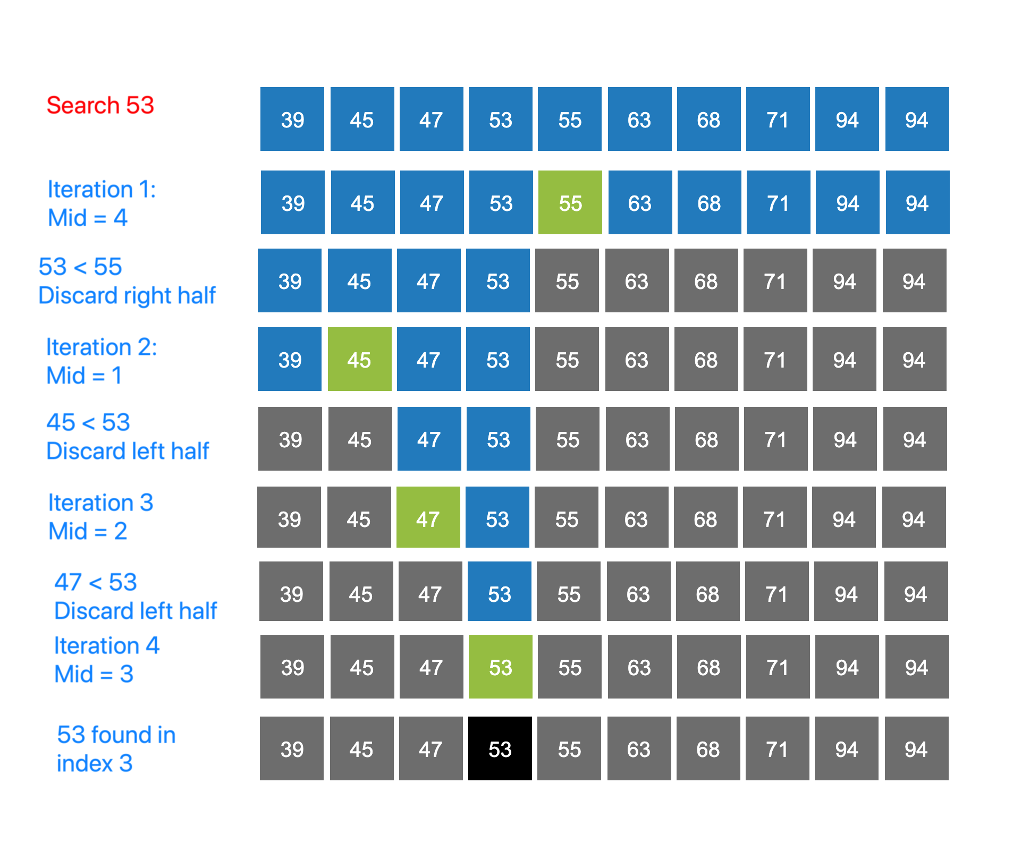
Binary Search Algorithm
Case | Time Complexity
Best Case | O(1)
Average Case | O(logn)
Worst Case | O(logn)
Space Complexity | O(1)

Slide 37
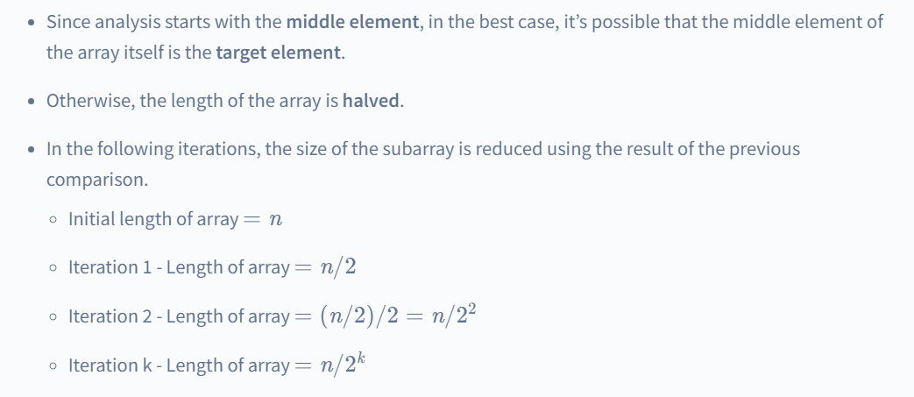
Binary Search Complexity

Slide 38
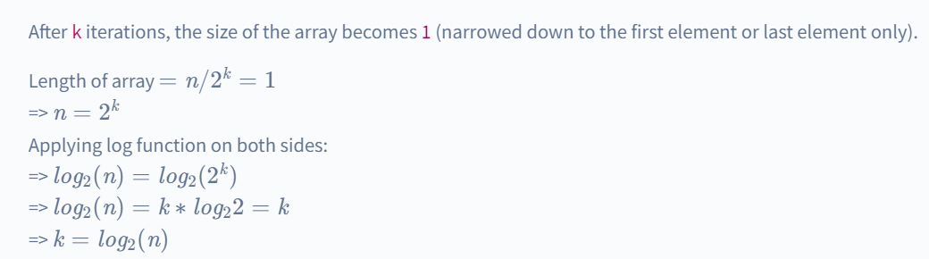
Binary Search Complexity

Slide 39
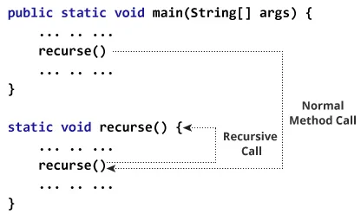
Recursion
A method that calls itself is known as a recursive method. And, this process is known as recursion.

Slide 40
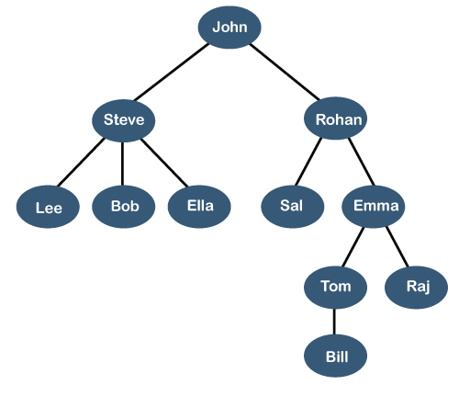
Tree
A tree is a nonlinear hierarchical data structure that consists of nodes connected by edges.
Trees are used in computer science and data structures to represent hierarchical relationships, such as file systems, organization charts, or the structure of a webpage.
They're useful for organizing and accessing data efficiently, and they can be simple or complex, depending on the specific application.

Slide 41
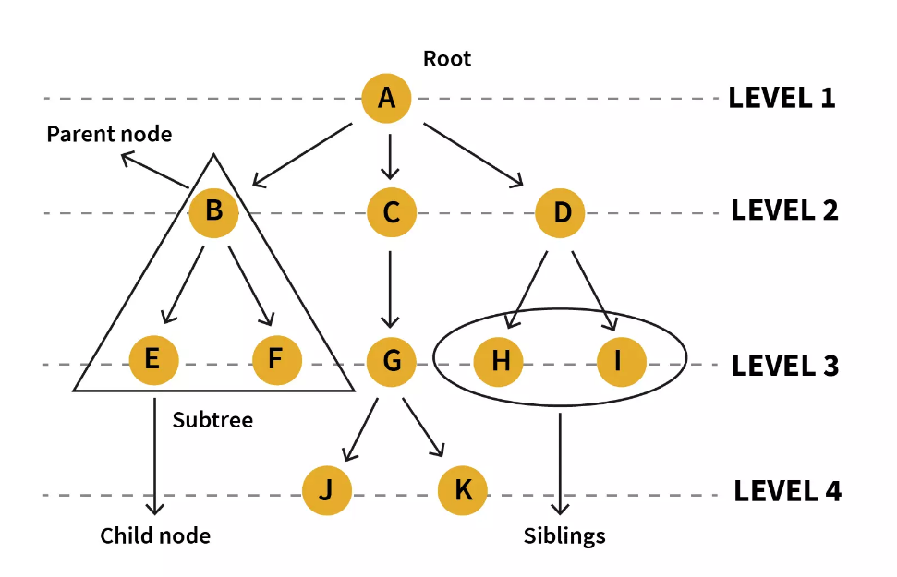
Tree Terminologies

Slide 42
Tree Terminologies
Terminology | Description | Diagram
Root | Root node is a node from which the entire tree originates. It does not have a parent | Node A
Parent Node | An immediate predecessor of any node is its parent node. | B is parent of E & F
Child Node | All immediate successors of a node are its children. The relationship between the parent and child is considered as the parent-child relationship. | F & E are children of B
Leaf | Node which does not have any child is a leaf. Usually the boundary nodes of a tree or last nodes of the tree are the leaf or collectively called leaves of the tree. | E, F, J, K, H, I are the leaf nodes.

Slide 43
Tree Terminologies
Edge | Edge is the connection represented by a line between one node to another.In a tree with n nodes, there will be ‘n-1’ edges in a tree. | Connecting line between A&B OR A&C OR B&F OR any other nodes connecting each other.
Siblings | Siblings in real life means people with the same parents, similarly in the case of trees, nodes with common parents are considered to be siblings. | H&I are siblings
Path | Path is a number of successive edges from source node to destination node. | A ,C, G, K is path from node A to K
Height of Node | Height of a node represents the number of edges on the longest path between that node and a leaf. | A, C, G, K form a height. Height of A is no. of edges between A and K,, which is 3. Similarly the height of G is 1 as it has just one edge until the next leaf node.

Slide 44
Tree Terminologies
Levels of node | Level of a node represents the generation of a node. If the root node is at level 0, then its next child node is at level 1, its grandchild is at level 2, and so on | Level of H, I & J is 3. Level of D, E, F & G is 2
Degree of Node | Degree of a node implies the number of child nodes a node has. | Degree of D is 2 and of C is 3
Visiting | When you’ve iterated or traversed to a specific node programmatically, accessing value or checking value of the current node is called visiting.
Internal Node | A node that has at least one child is known as an internal node. | All the nodes except E, F, J, K, H, I are internal.

Slide 45
Tree Terminologies
Traversing | Traversing is a process of visiting each node in a specific order in a tree data structure. | There are three types of traversals: inorder, preorder, postorder traversal.
Ancestor node | An ancestor or ancestors to a node are all the predecessor nodes from root until that node. I.e. any parent or grandparent and so on of a specific node are its ancestors. | A, C & G are ancestor to K and J nodes
Descendant | Immediate successor of a node is its descendent. | K is descendent of G
Sub tree | Descendants of a node represent subtree. Tree being a recursive data structure can contain many subtrees inside of it. | Nodes B, E, F represent one subtree.

Slide 46
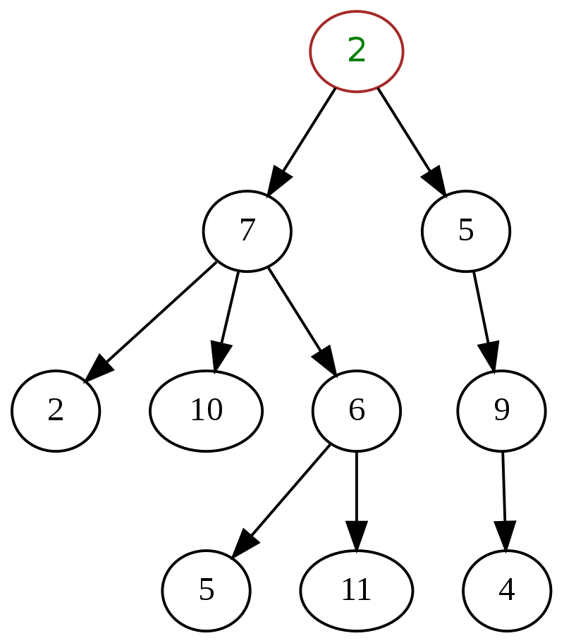
General Tree
In the general tree, each node has either 0 or n number of nodes.
In this tree, there is no limitation to the number of nodes. It starts with a root node and the children of the parent node make another general sub tree.
Hence each node is a root of another sub-tree i.e. there can be `n number of subtrees in a general tree.
All the subtrees are unordered in a general tree.

Slide 47
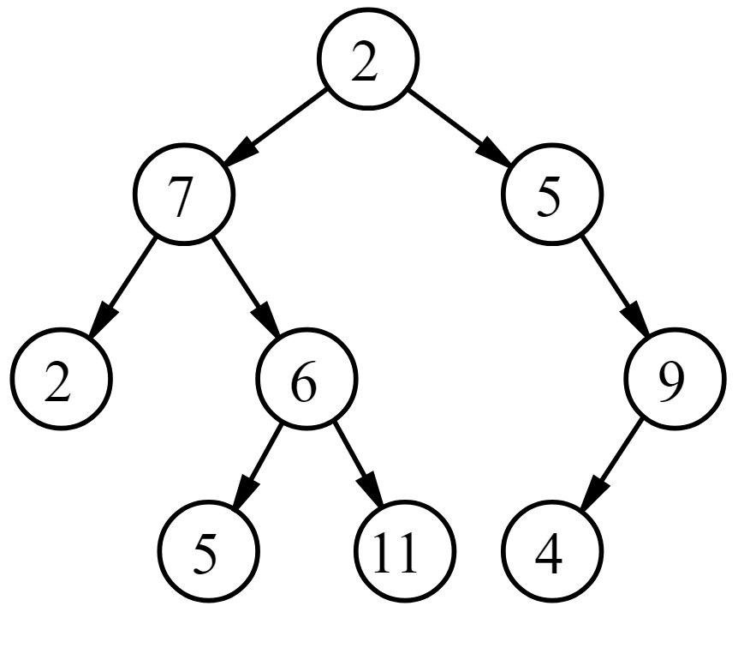
Binary Tree
In a binary tree, any node can have a maximum of 0, 1, or 2 nodes

Slide 48
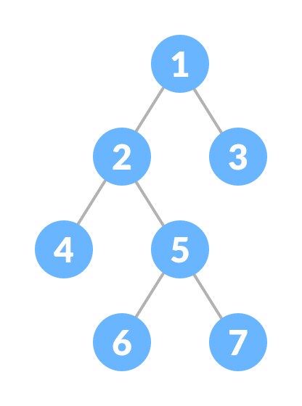
Full Binary Tree
A full Binary tree is a special type of binary tree in which every parent node/internal node has either two or no children.

Slide 49
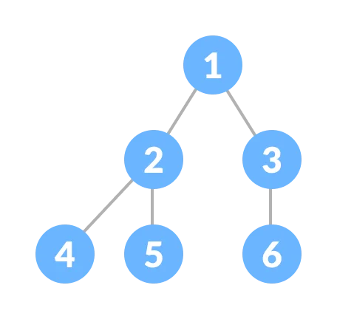
Complete Binary Tree
A complete binary tree is just like a full binary tree, but with two major differences
Every level must be completely filled
All the leaf elements must lean towards the left.
The last leaf element might not have a right sibling i.e. a complete binary tree doesn't have to be a full binary tree.

Slide 50
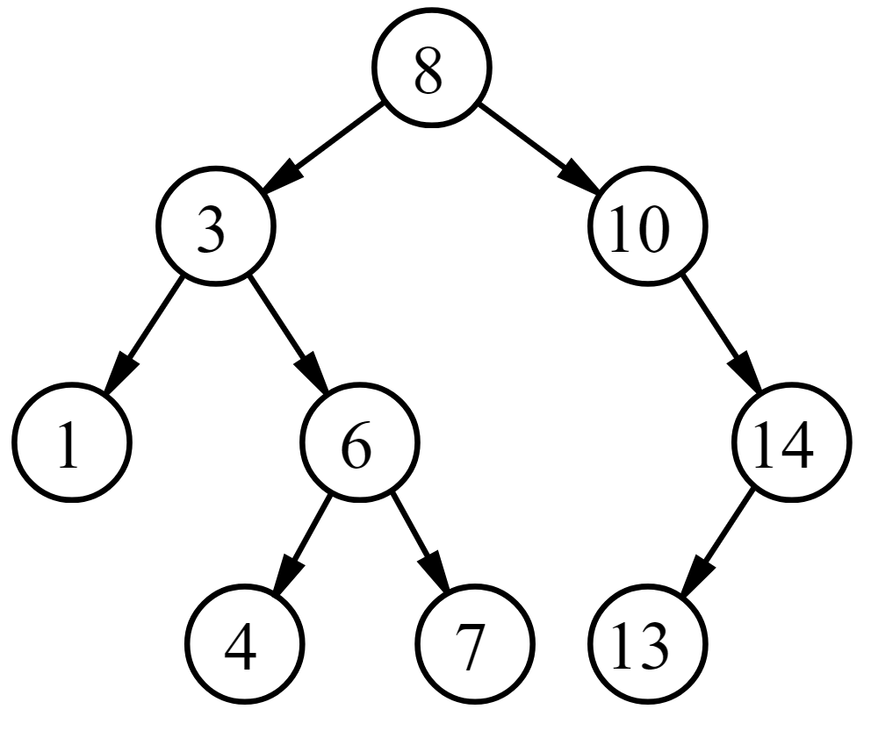
Binary Search Tree
Binary search tree is a data structure that quickly allows us to maintain a sorted list of numbers.
It is called a binary tree because each tree node has a maximum of two children.
It is called a search tree because it can be used to search for the presence of a number in O(log(n)) time.
The properties that separate a binary search tree from a regular binary tree is
All nodes of left subtree are less than the root node
All nodes of right subtree are more than the root node
Both subtrees of each node are also BSTs i.e. they have the above two properties

Slide 51
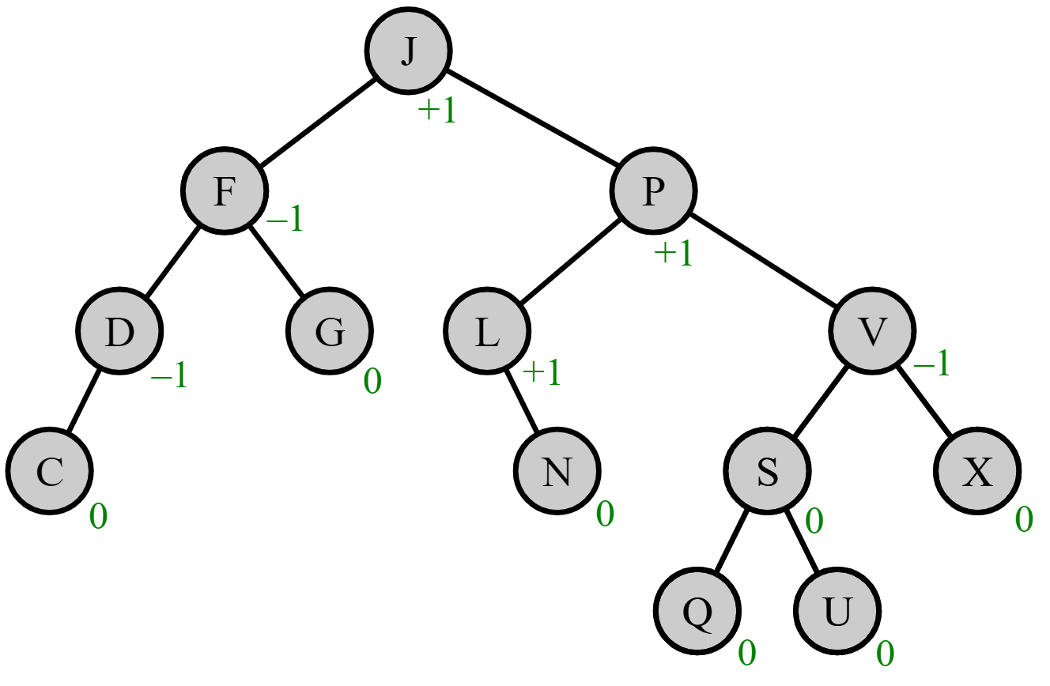
AVL Tree
It can be considered as a binary tree and also a type of binary search tree. It satisfies features of both binary tree and binary search tree.
It's a self balancing tree i.e. balancing heights of left subtree and right subtree. This balancing is measured by something called balancing factor.
A tree is considered as an AVL tree if it satisfies properties of both a binary search tree and the balancing factor. Difference between the height of the left subtree and the right subtree is considered as the height of the AVL tree.The value of the balancing factor must be 0, 1 or -1 for each node in an AVL tree.

Slide 52
BST Operations
Create: creates an empty tree.
Insert: insert a node in the tree.
Search: Searches for a node in the tree.
Delete: deletes a node from the tree.
Inorder: in-order traversal of the tree.
Preorder: pre-order traversal of the tree.
Postorder: post-order traversal of the tree.

Slide 53

Binary Search Tree Insertion

Slide 54
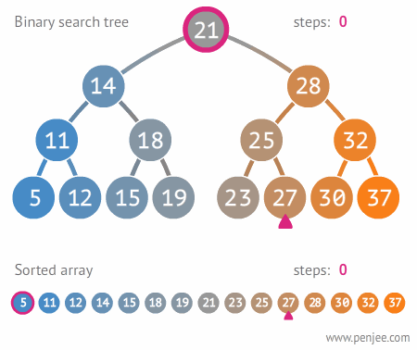
Binary Search Tree Searching

Slide 55
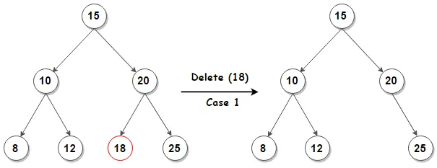
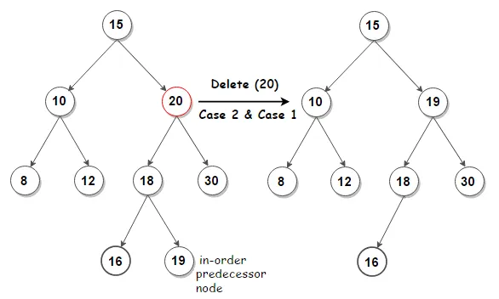
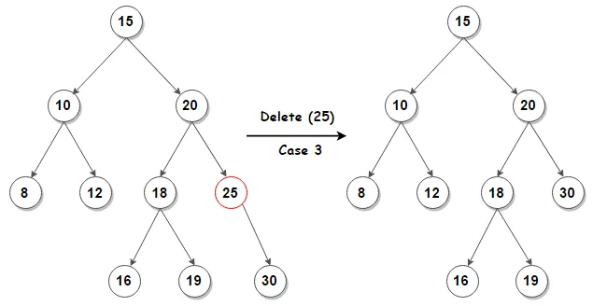
Binary Search Tree Delete

Slide 56
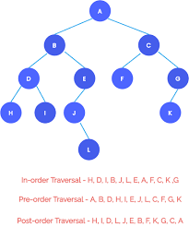
Binary Search Tree Traversal

Slide 57
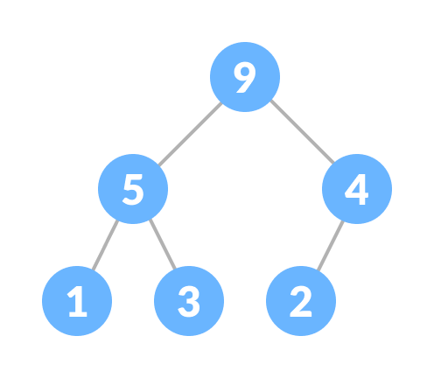
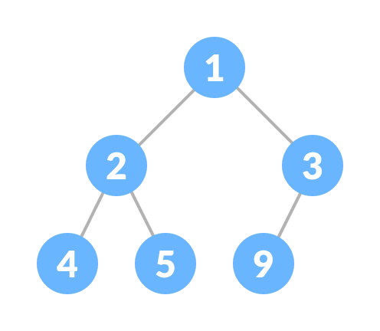
Heap Data Structure
Heap data structure is a complete binary tree that satisfies the heap property, where any given node is
always greater than its child node/s and the key of the root node is the largest among all other nodes. This property is also called max heap property.
always smaller than the child node/s and the key of the root node is the smallest among all other nodes. This property is also called min heap property.

Slide 58
Applications Of Tree Data Structures
Storing naturally hierarchical data
Database indexing
Parsing
Artificial Intelligence
Cryptography

Slide 59
Graph Data Structure
A Graph is a non-linear data structure that consists of nodes and edges. The nodes are sometimes referred to as vertices and edges are the lines that connect any two nodes or vertices in the graph.
“A Graph is a pair of sets. G = (V, E). V is the set of vertices. E is a set of edges. E is made up of pairs of elements from V (unordered pair)”
There are 2 types of graphs:
Directed
Undirected

Slide 60
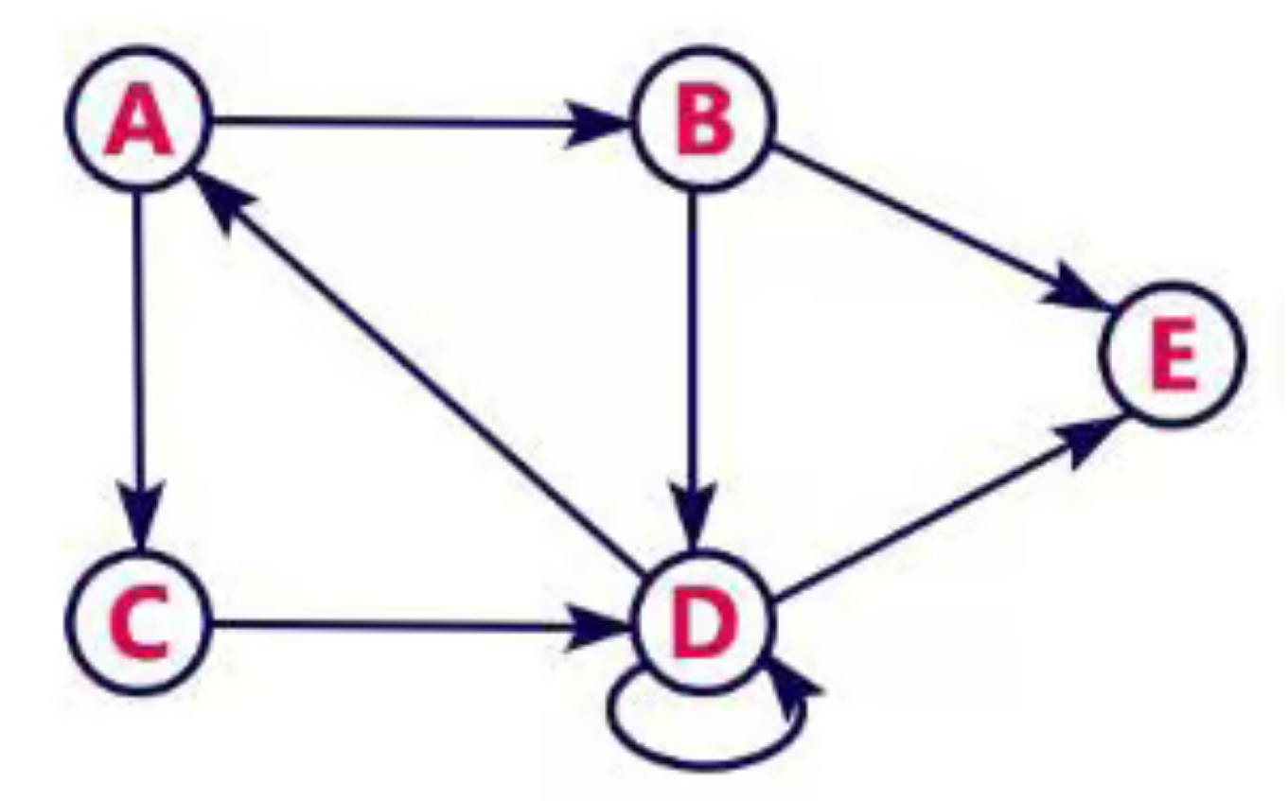
Directed Graph
A graph with only directed edges is said to be a directed graph.
Example
The following directed graph has 5 vertices and 8 edges. This graph G can be defined as G = (V, E), where V = {A,B,C,D,E} and E = {(A,B), (A,C) (B, E), (B,D), (D, A), (D, E),(C,D),(D,D)}.

Slide 61
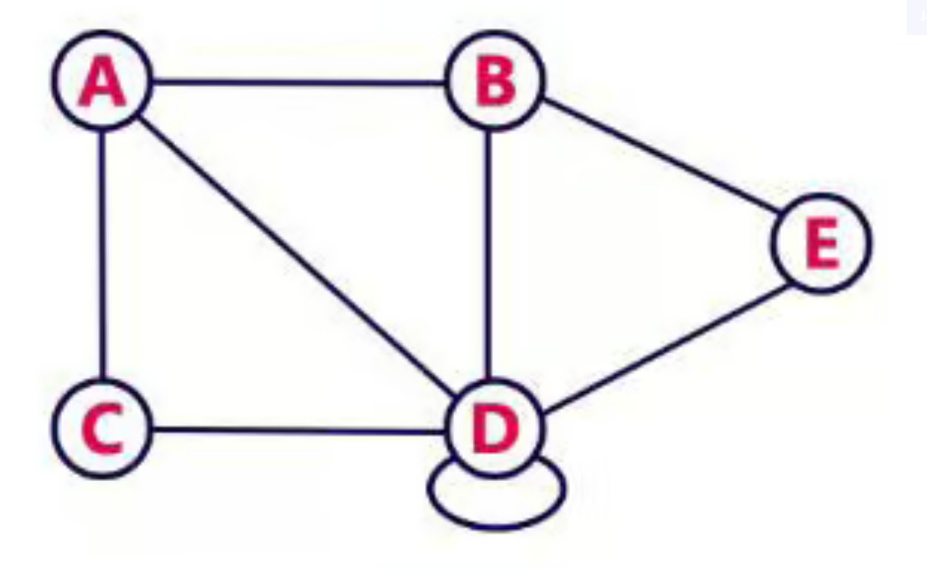
Undirected Graph
A graph with only undirected edges is said to be an undirected graph.

Slide 62
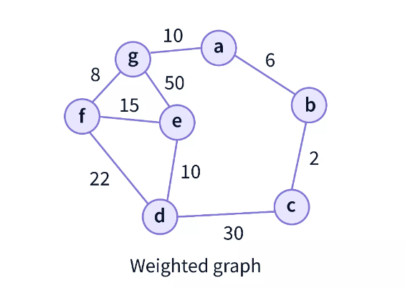
Weighted Graph
In weighted graphs, each edge has a value associated with them (called weight). It refers to a simple graph that has weighted edges. The weights are usually used to compute the shortest path in the graph.

Slide 63
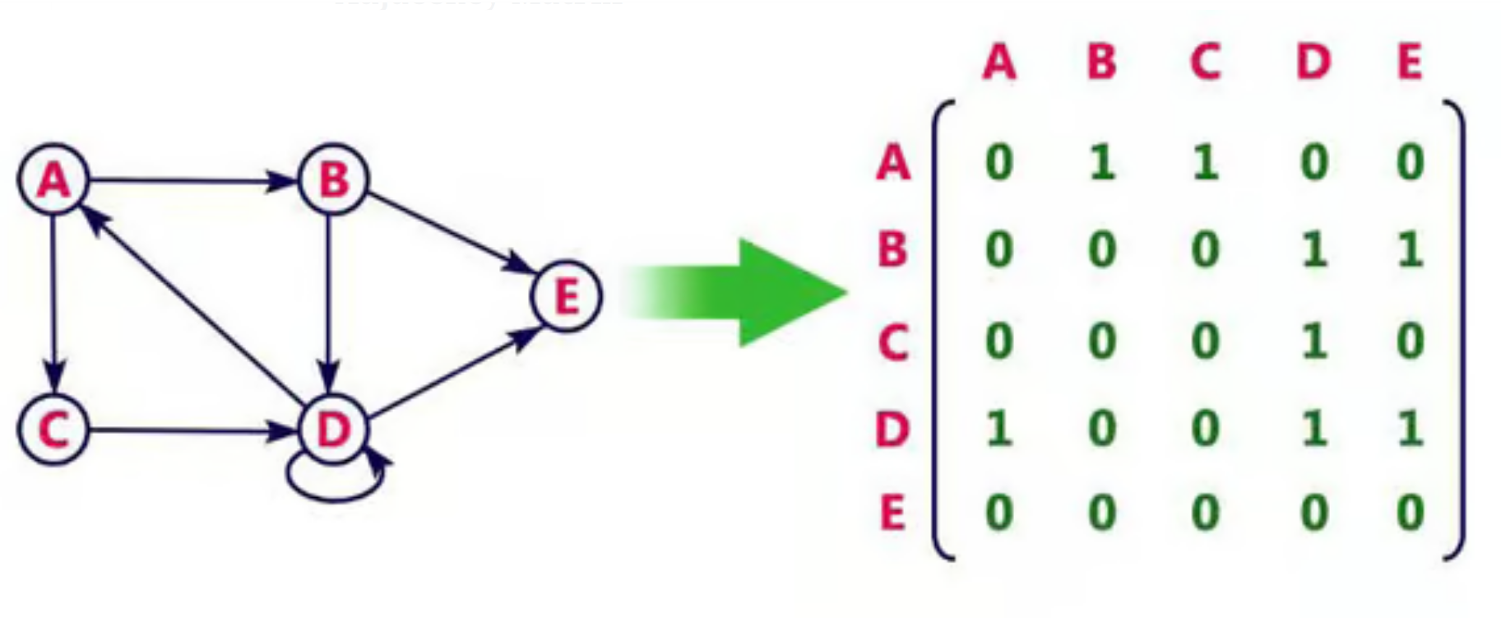
Adjacency Matrix
In this representation, the graph can be represented using a matrix of size n x n, where n is the number of vertices.
This matrix is filled with either 1’s or 0’s.
Here, 1 represents that there is an edge from row vertex to column vertex, and 0 represents that there is no edge from row vertex to column vertex.

Slide 64
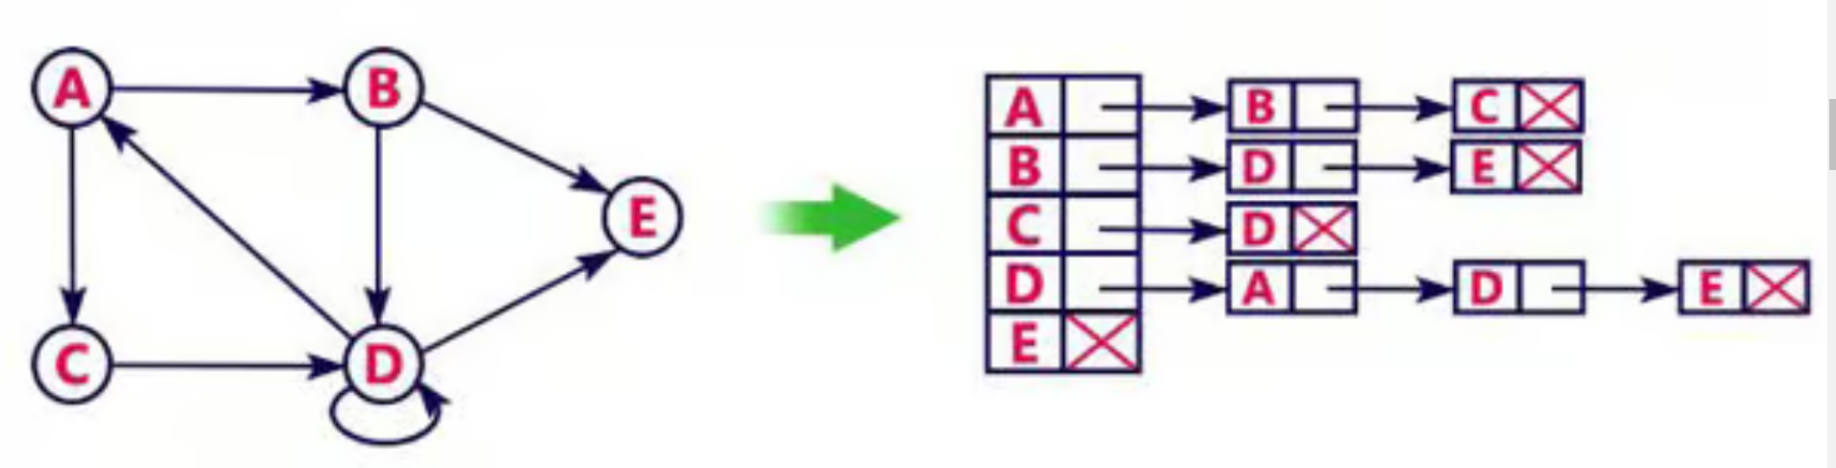
Adjacency List
In this representation, every vertex of the graph contains a list of its adjacent vertices.
If the graph is not dense, i.e., the number of edges is less, then it is efficient to represent the graph through the adjacency list.

Slide 65
BFS Traversing
Steps for BFS algorithms:
Take the data for the graph's adjacency matrix or adjacency list.
Create a queue and fill it with items.
Activate the root node (meaning that get the root node at the beginning of the queue).
Dequeue the queue's head (or initial element), then enqueue all of the queue's nearby nodes from left to right. Simply dequeue the head and resume the operation if a node has no nearby nodes that need to be investigated. (Note: If a neighbor emerges that has previously been investigated or is in the queue, don't enqueue it; instead, skip it.)
Continue in this manner until the queue is empty.

Slide 66
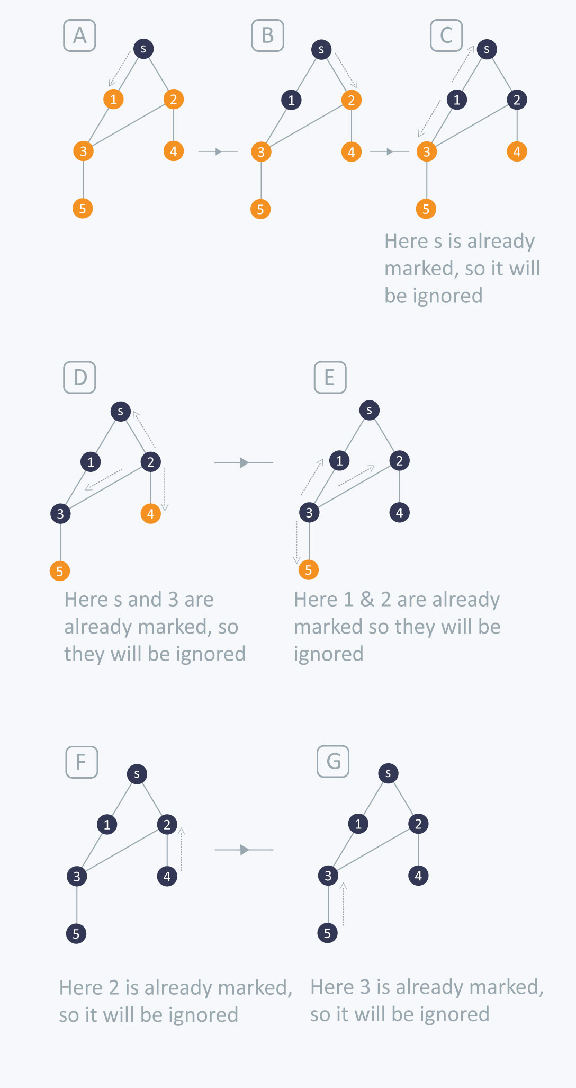
BFS Traversing

Slide 67
BFS Traversing
BFS (G, s) //Where G is the graph and s is the source node
let Q be queue.
Q.enqueue( s ) //Inserting s in queue until all its neighbour vertices are marked.
mark s as visited.
while ( Q is not empty)
//Removing that vertex from queue,whose neighbour will be visited now
v = Q.dequeue( )
//processing all the neighbours of v
for all neighbours w of v in Graph G
if w is not visited
Q.enqueue( w ) //Stores w in Q to further visit its neighbour
mark w as visited.

Slide 68
DFS Traversing
Steps for DFS algorithms:
First, create a stack with the total number of vertices in the graph.
Now, choose any vertex as the starting point of traversal, and push that vertex into the stack.
After that, push a non-visited vertex (adjacent to the vertex on the top of the stack) to the top of the stack.
Now, repeat steps 3 and 4 until no vertices are left to visit from the vertex on the stack's top.
If no vertex is left, go back and pop a vertex from the stack.
Repeat steps 2, 3, and 4 until the stack is empty.

Slide 69
DFS-iterative (G, s): //Where G is graph and s is source vertex
let S be stack
S.push( s ) //Inserting s in stack
mark s as visited.
while ( S is not empty):
//Pop a vertex from stack to visit next
v = S.top( )
S.pop( )
//Push all the neighbours of v in stack that are not visited
for all neighbours w of v in Graph G:
if w is not visited :
S.push( w )
mark w as visited
DFS-recursive(G, s):
mark s as visited
for all neighbours w of s in Graph G:
if w is not visited:
DFS-recursive(G, w)

Slide 70
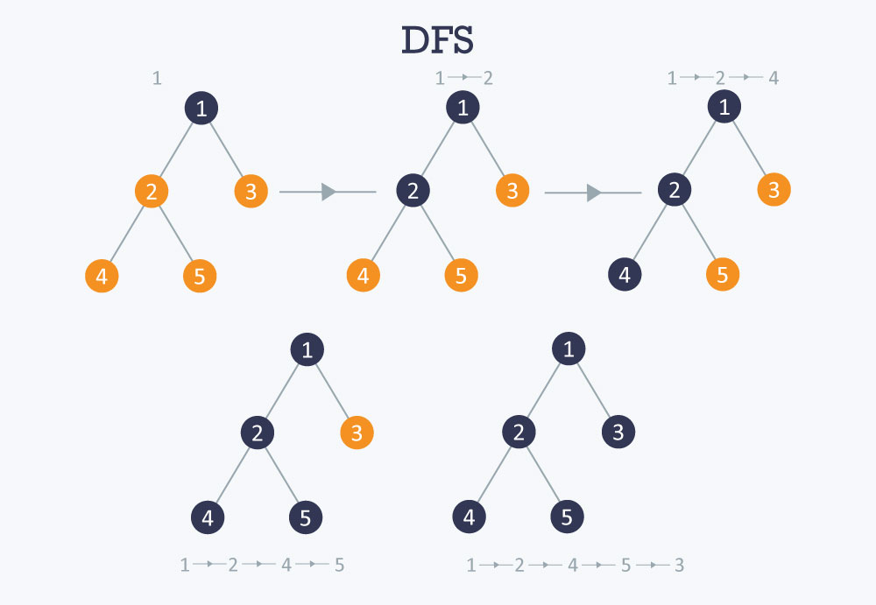

Slide 71
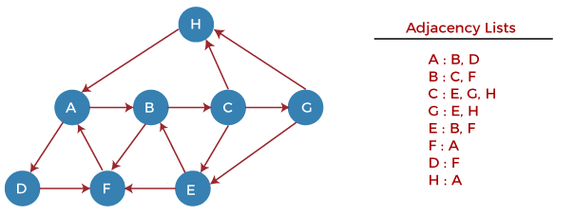

Slide 72
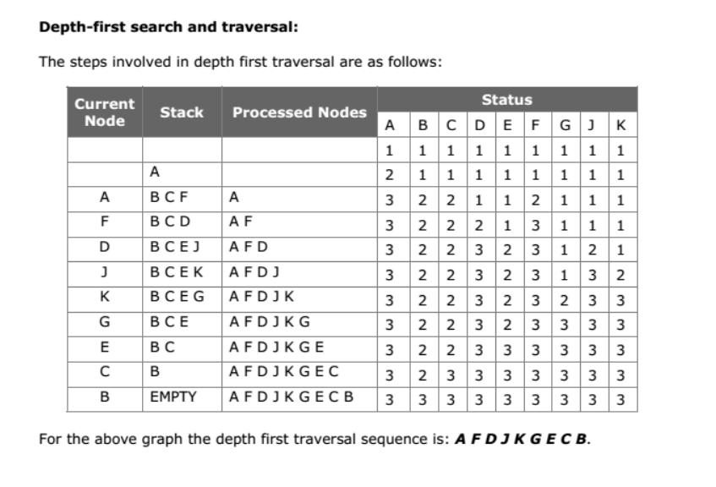

Slide 73
Applications Of Graph Data Structures
Social Networks
Google Maps
Web Crawlers
Recommendation Engines
Program Dependencies

Slide 74
Hashing
Hashing is a technique of mapping a large set of arbitrary data to tabular indexes using a hash function. It is a method for representing dictionaries for large datasets.
It allows lookups, updating and retrieval operation to occur in a constant time i.e. O(1).
The Hash table data structure stores elements in key-value pairs where
Key- unique integer that is used for indexing the values
Value - data that are associated with keys.

Slide 75
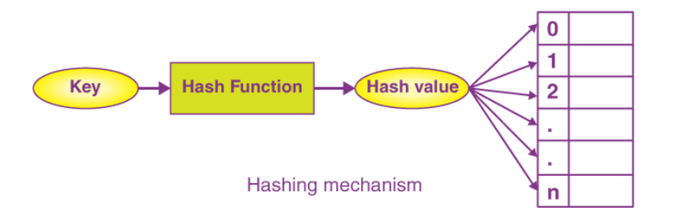
Hash Function
In a hash table, a new index is processed using the keys. And, the element corresponding to that key is stored in the index. This process is called hashing.
Let k be a key and h(x) be a hash function.
Here, h(k) will give us a new index to store the element linked with k.

Slide 76

Hash Table

Slide 77
Hash Collision
When the hash function generates the same index for multiple keys, there will be a conflict (what value to be stored in that index). This is called a hash collision.
We can resolve the hash collision using one of the following techniques.
Collision resolution by chaining
Open Addressing: Linear/Quadratic Probing and Double Hashing

Slide 78

Collision Resolution By Chaining
In chaining, if a hash function produces the same index for multiple elements, these elements are stored in the same index by using a doubly-linked list.

Slide 79
Collision Resolution By Open Addressing
Linear Probing
In linear probing, collision is resolved by checking the next slot.
h(k, i) = (h′(k) + i) mod m
where
i = {0, 1, ….}
h'(k) is a new hash function
If a collision occurs at h(k, 0), then h(k, 1) is checked. In this way, the value of i is incremented linearly.

Slide 80
Collision Resolution By Open Addressing
ii. Quadratic Probing
It works similar to linear probing but the spacing between the slots is increased (greater than one) by using the following relation.
h(k, i) = (h′(k) + c1i + c2i^2) mod m
where,
c1 and c2 are positive auxiliary constants,
i = {0, 1, ….}

Slide 81
Collision Resolution By Open Addressing
ii. Double Hashing
If a collision occurs after applying a hash function h(k), then another hash function is calculated for finding the next slot.
h(k, i) = (h1(k) + ih2(k)) mod m

Slide 82


Slide 83


Slide 84
QuickSort
Quicksort is a divide-and-conquer algorithm. It works by selecting a 'pivot' element from the array and partitioning the other elements into two sub-arrays, according to whether they are less than or greater than the pivot. The sub-arrays are then sorted recursively.
Algorithm
Pick an element, called a pivot, from the array.
Partitioning: reorder the array so that all elements with values less than the pivot come before the pivot, while all elements with values greater than the pivot come after it (equal values can go either way). After this partitioning, the pivot is in its final position. This is called the partition operation.
Recursively apply the above steps to the sub-array of elements with smaller values and separately to the sub-array of elements with greater values.

Slide 85


Slide 86


Slide 87
QuickSort Complexity
Best Case Complexity - In Quicksort, the best-case occurs when the pivot element is the middle element or near to the middle element. The best-case time complexity of quicksort is O(n*logn).
Average Case Complexity - It occurs when the array elements are in jumbled order that is not properly ascending and not properly descending. The average case time complexity of quicksort is O(n*logn).
Worst Case Complexity - In quick sort, worst case occurs when the pivot element is either greatest or smallest element. Suppose, if the pivot element is always the last element of the array, the worst case would occur when the given array is sorted already in ascending or descending order. The worst-case time complexity of quicksort is O(n2).

Slide 88

Heap Sort
Heap sort works by visualizing the elements of the array as a special kind of complete binary tree called a heap.
A complete binary tree has an interesting property that we can use to find the children and parents of any node.
If the index of any element in the array is i, the element in the index 2i+1 will become the left child and element in 2i+2 index will become the right child. Also, the parent of any element at index i is given by the lower bound of (i-1)/2

Slide 89

Heapify Operation
Starting from a complete binary tree, we can
modify it to become a Max-Heap by running a function called heapify on all the non-leaf elements of the heap.
heapify(array)
Root = array[0]
Largest = largest( array[0] , array [2*0 + 1]. array[2*0+2])
if(Root != Largest)
Swap(Root, Largest)

Slide 90
Working of Heap Sort
The first step includes the creation of a heap by adjusting the elements of the array.
After the creation of heap, now remove the root element of the heap repeatedly by shifting it to the end of the array, and then store the heap structure with the remaining elements.

Slide 91

Heap Sort Example

Slide 92


Heap Sort Example
Next, we have to delete the root element (89) from the max heap. To delete this node, we have to swap it with the last node, i.e. (11). After deleting the root element, we again have to heapify it to convert it into max heap

Slide 93









Slide 94







Slide 95
Heap Sort Complexity
Case | Time Complexity
Best Case | O(n logn)
Average Case | O(n log n)
Worst Case | O(n log n)

